Slide 1
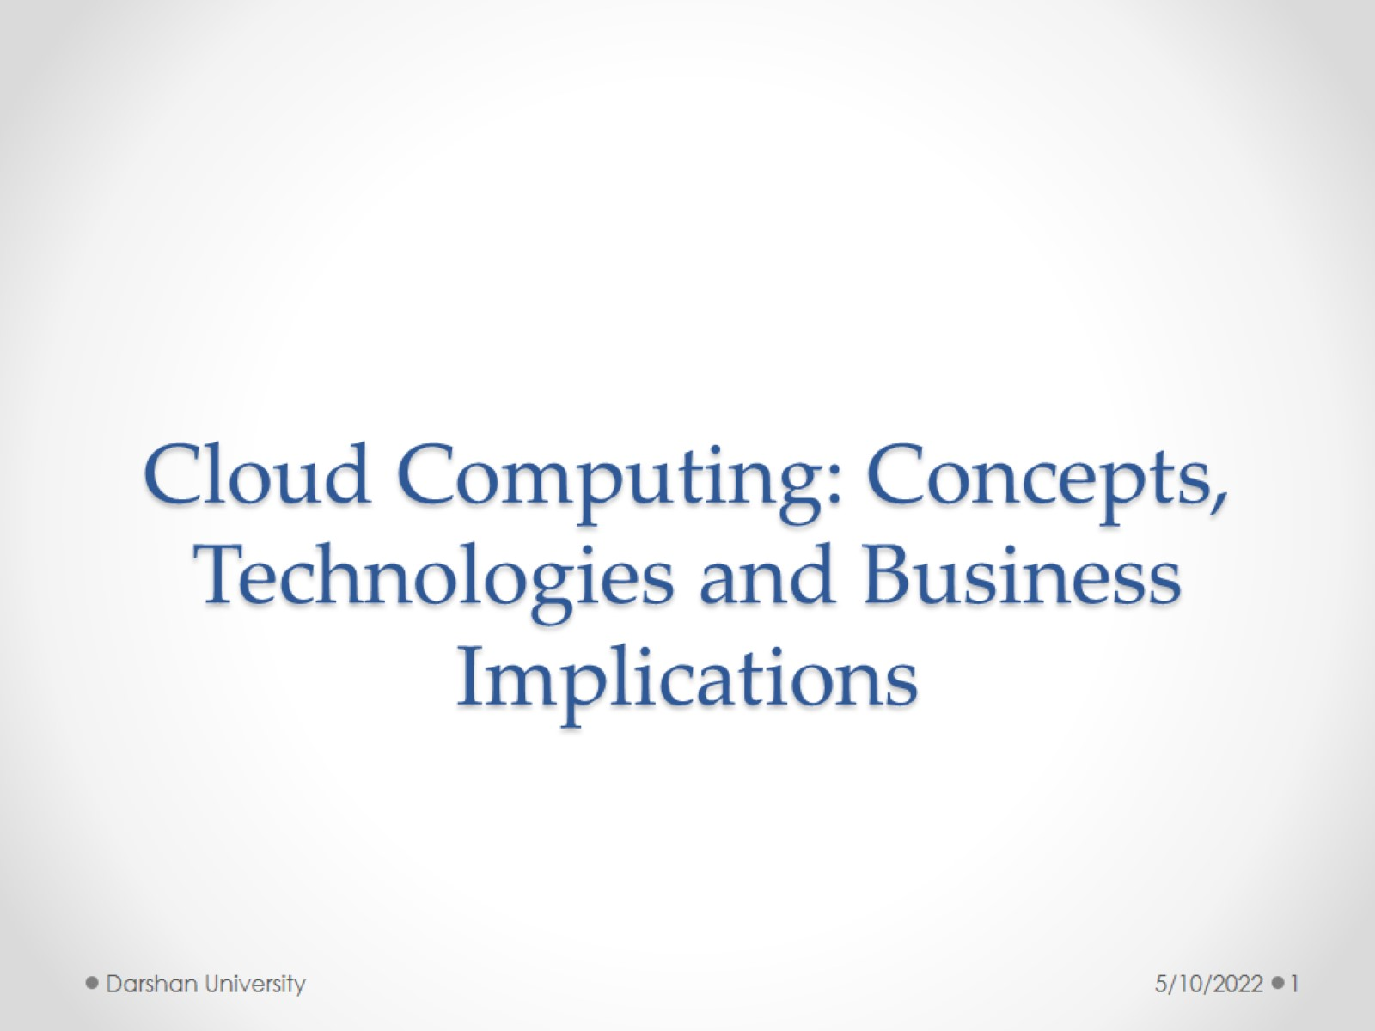
Cloud Computing: Concepts, Technologies and Business Implications

Slide 2
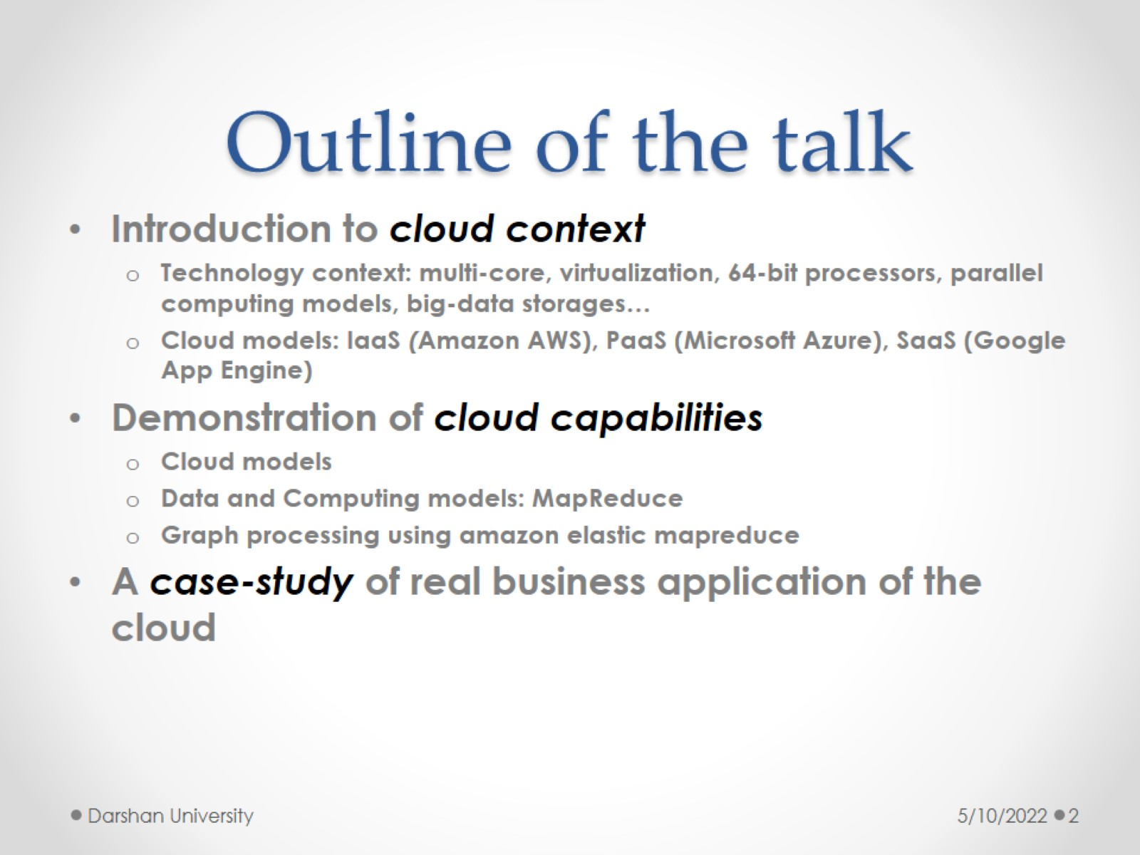
Outline of the talk

Slide 3
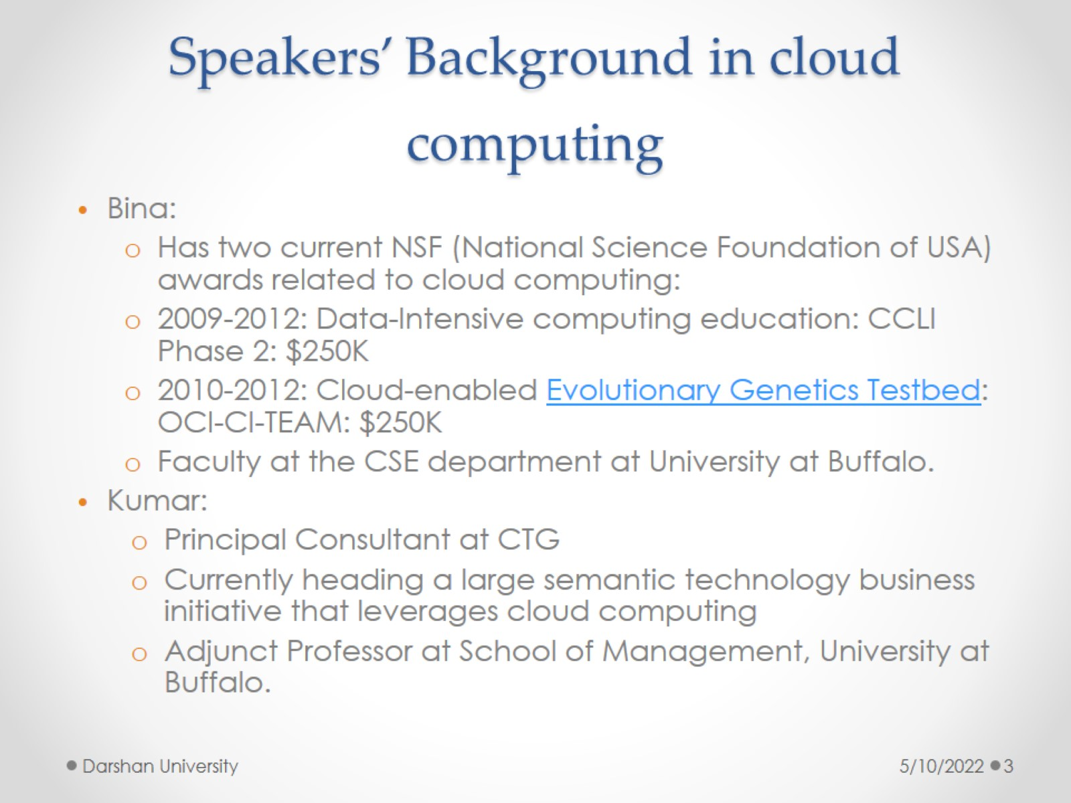
Speakers’ Background in cloud computing

Slide 4
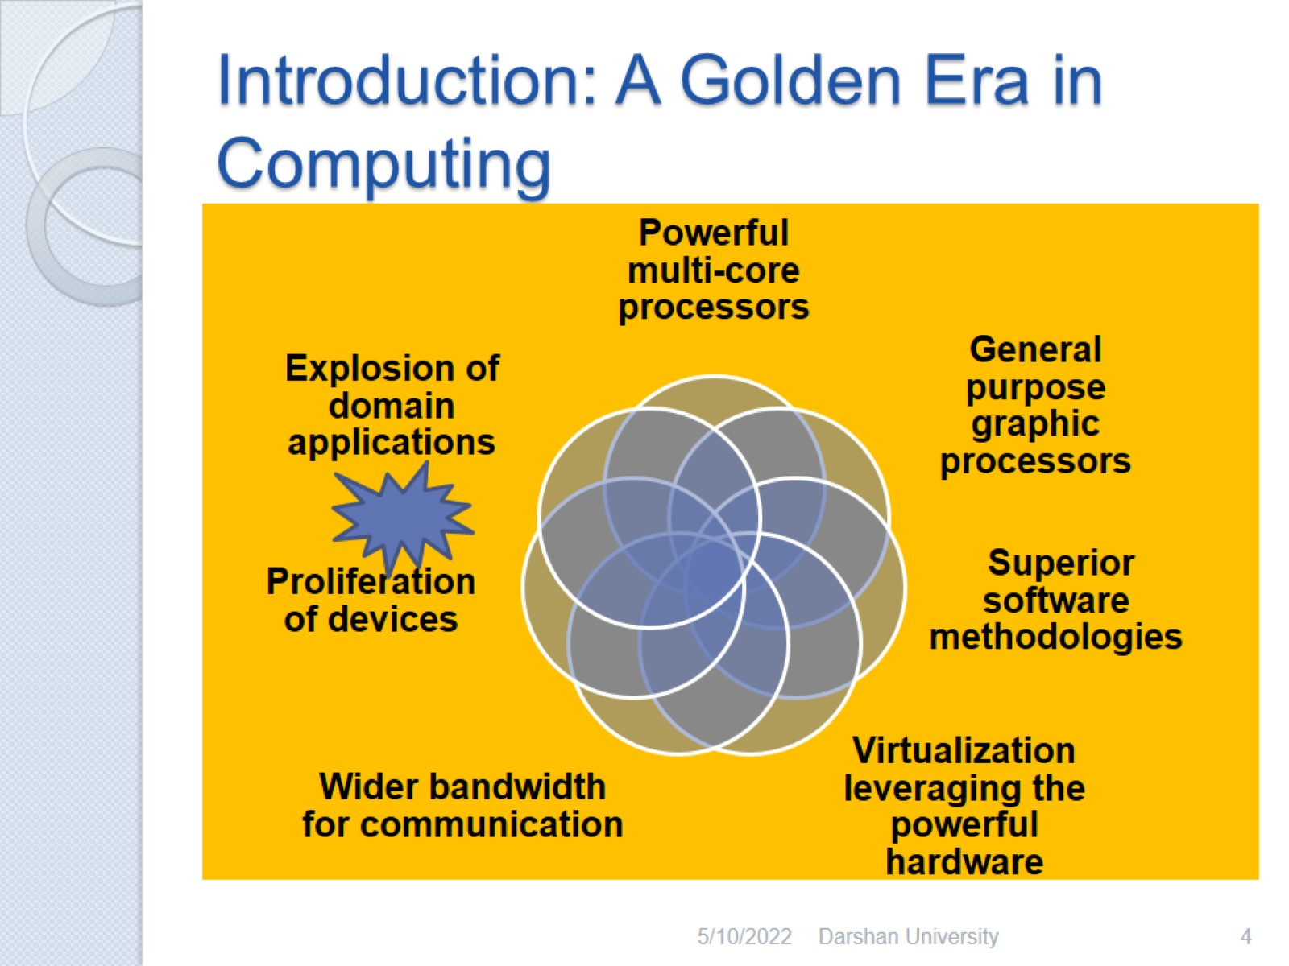
Introduction: A Golden Era in Computing

Slide 5
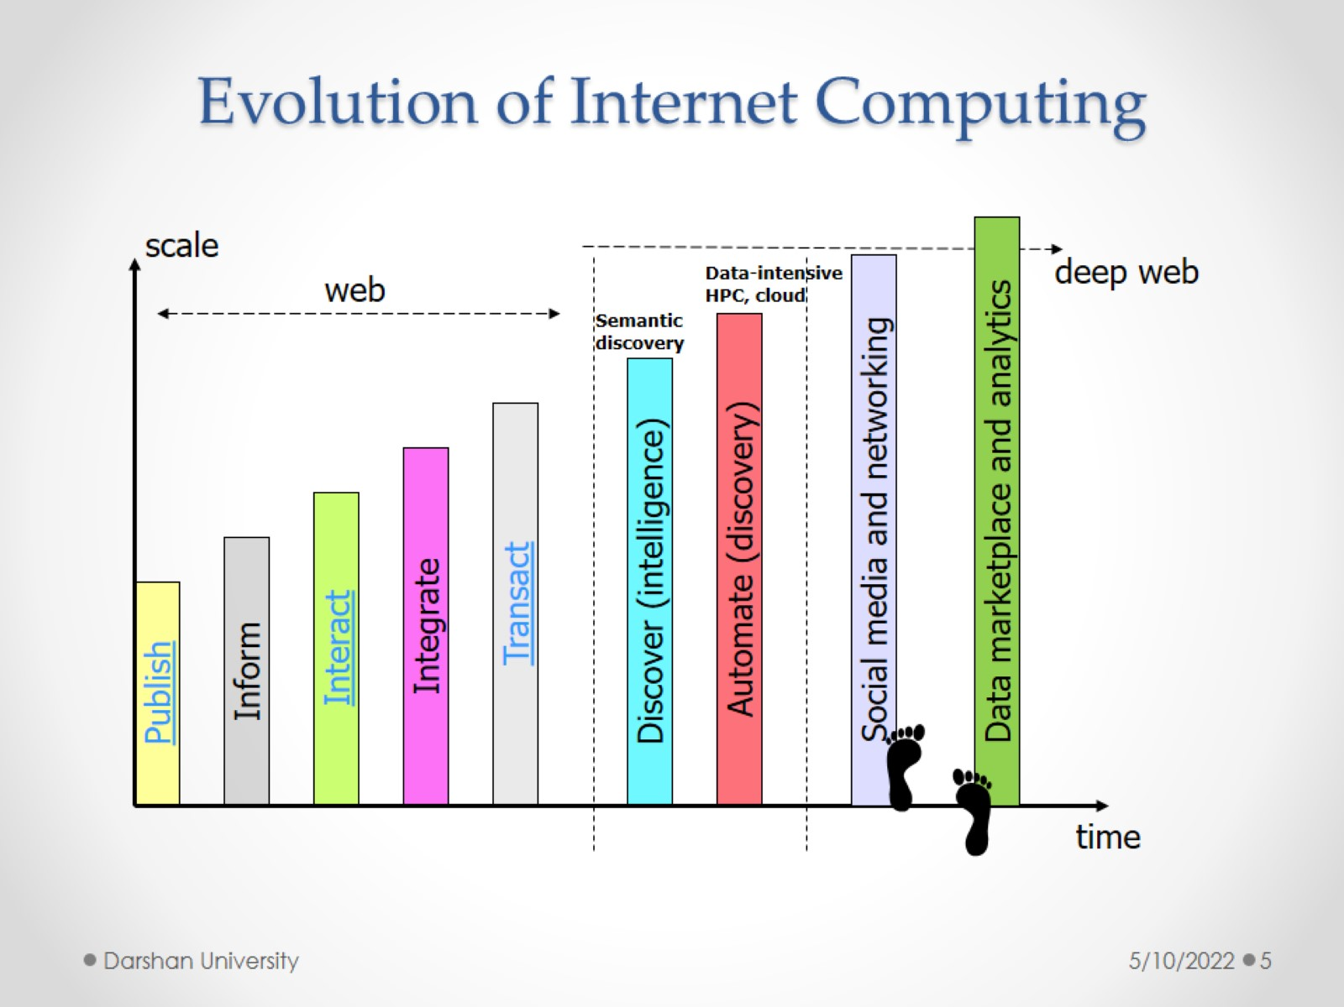
Evolution of Internet Computing

Slide 6
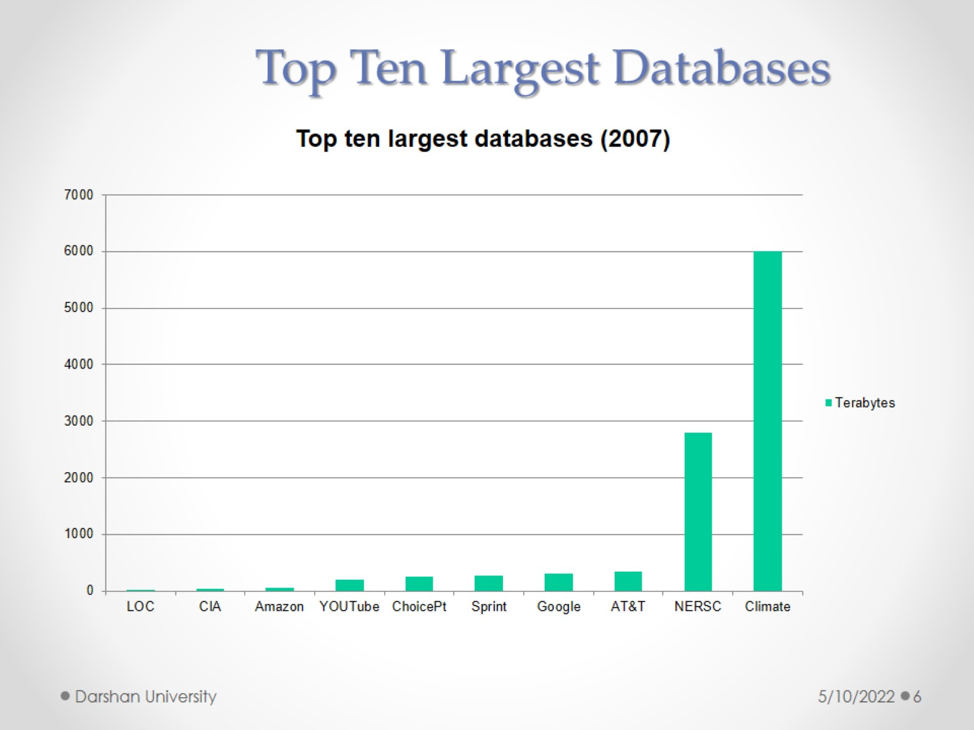

Slide 7
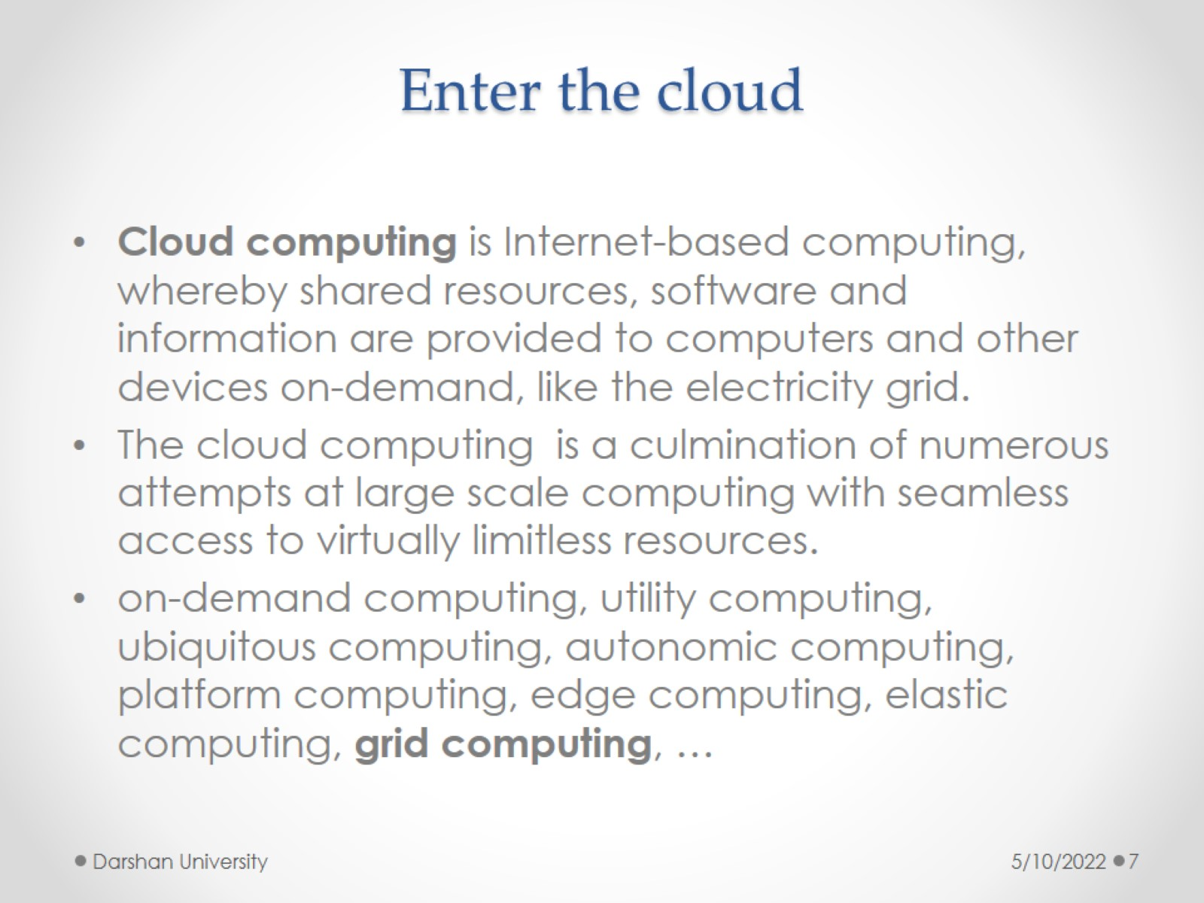
Enter the cloud

Slide 8
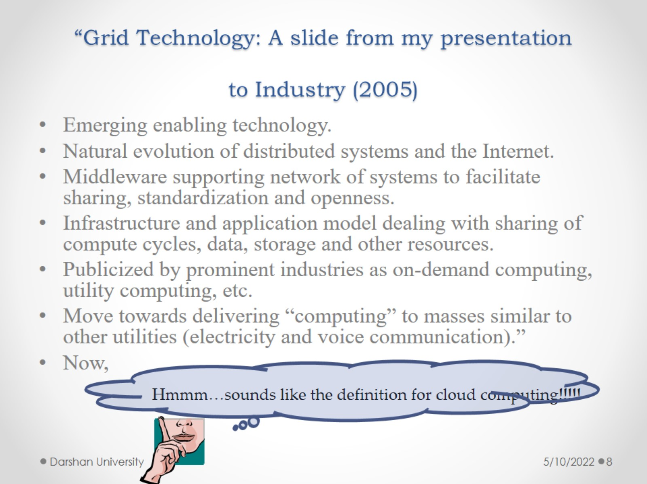
“Grid Technology: A slide from my presentation to Industry (2005)

Slide 9
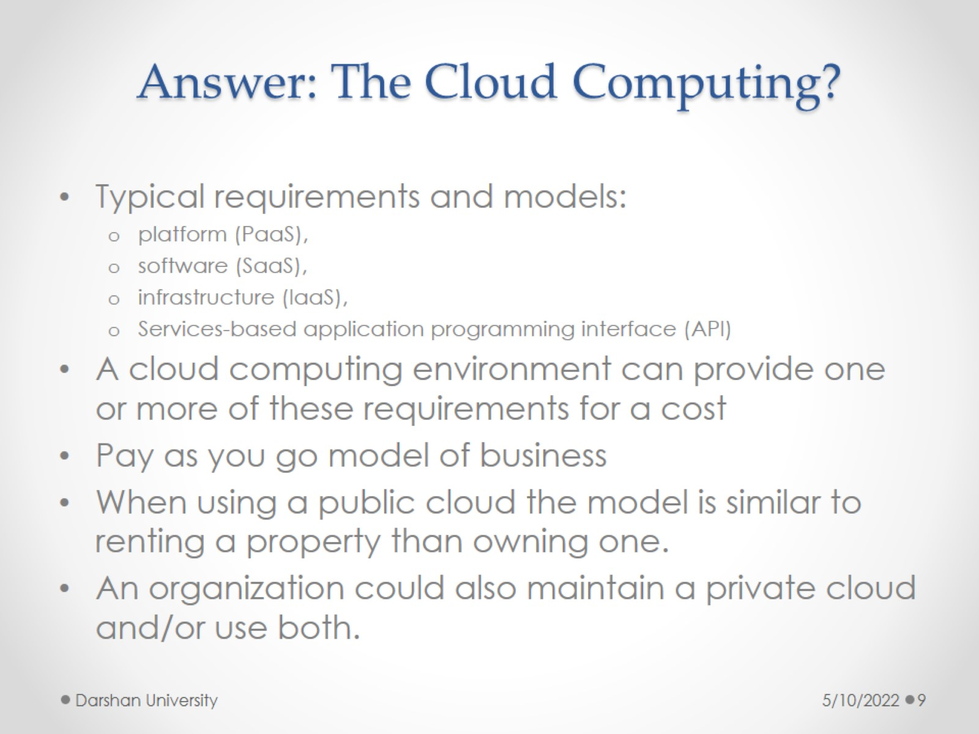
Answer: The Cloud Computing?

Slide 10
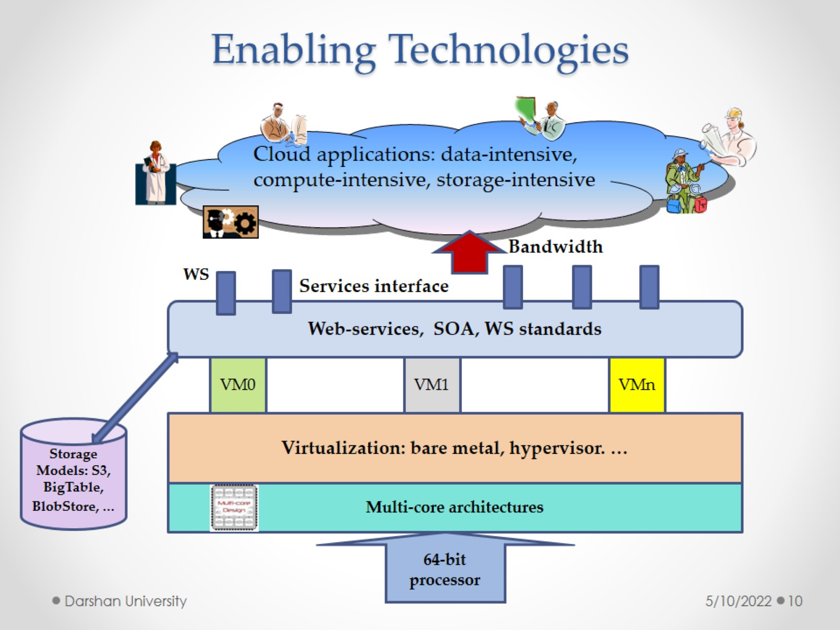
Enabling Technologies

Slide 11
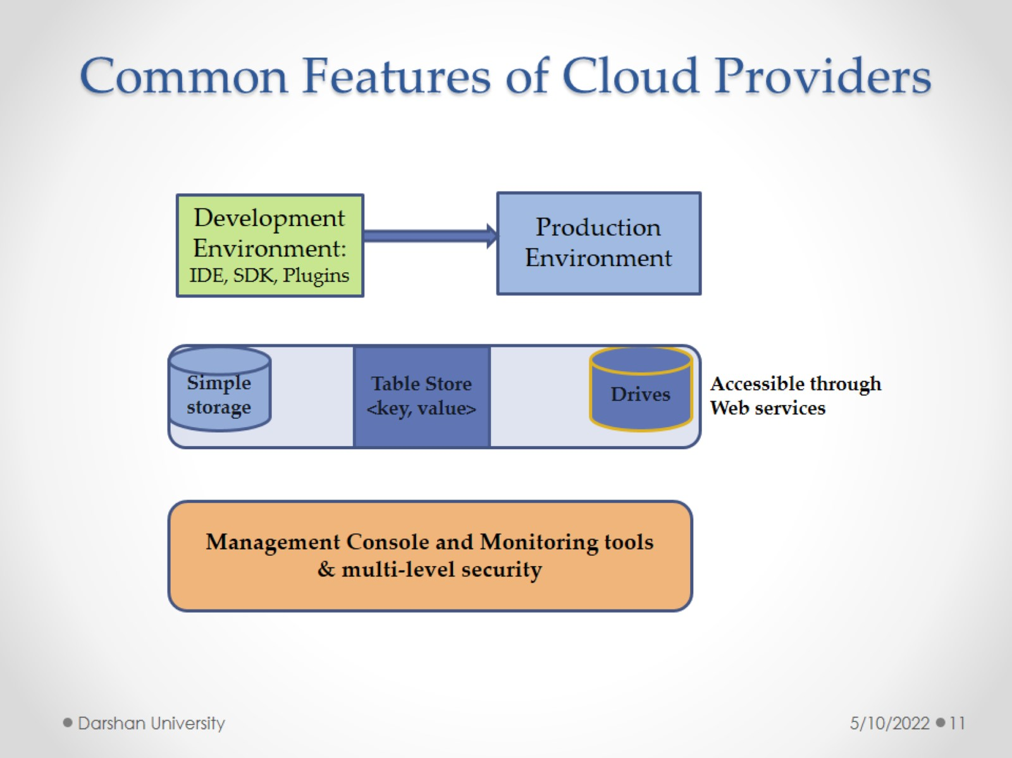
Common Features of Cloud Providers

Slide 12
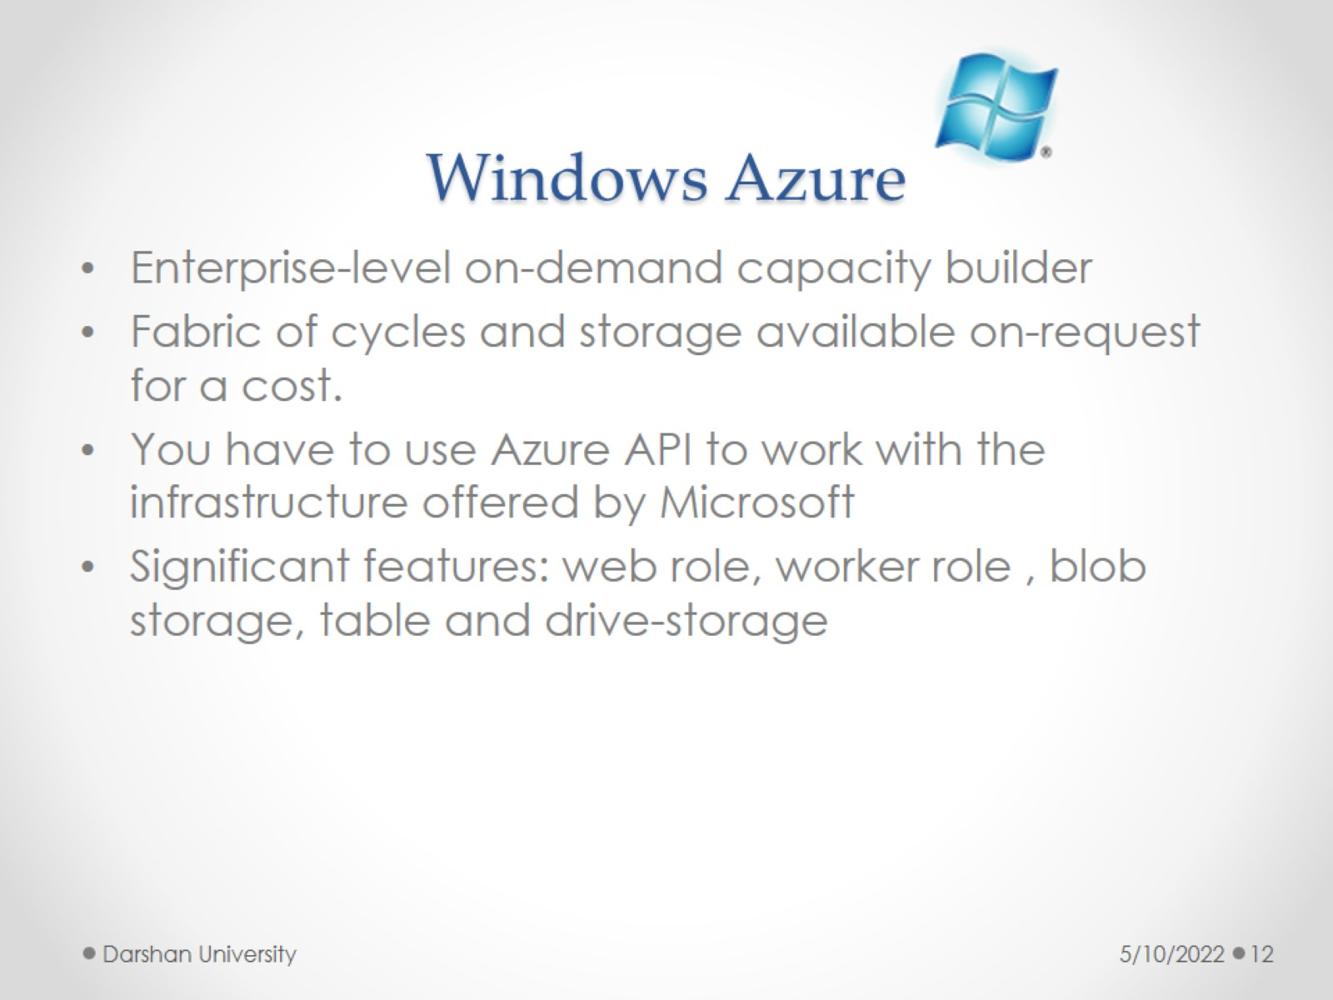
Windows Azure

Slide 13
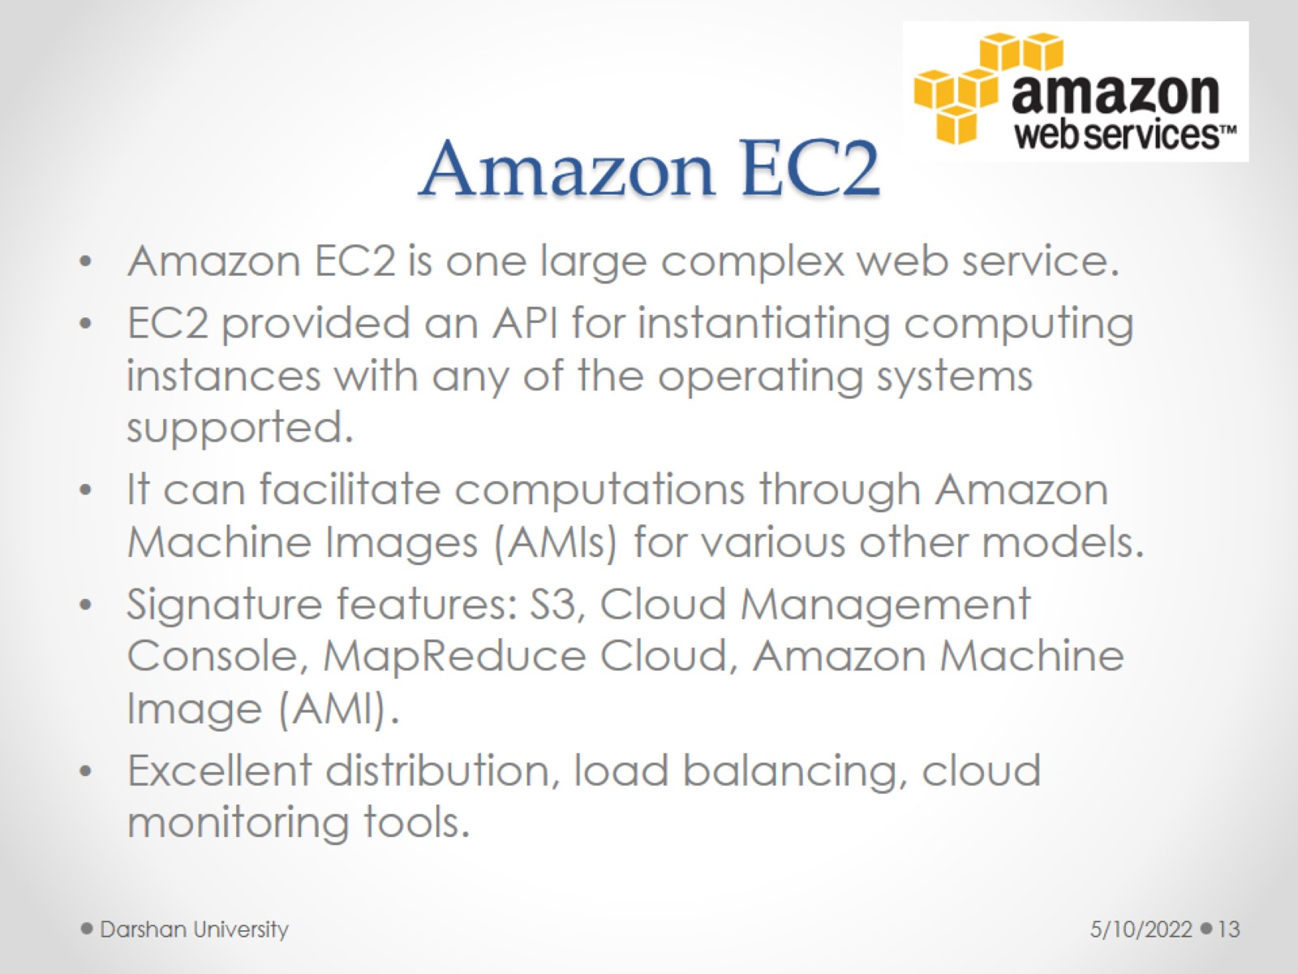
Amazon EC2

Slide 14
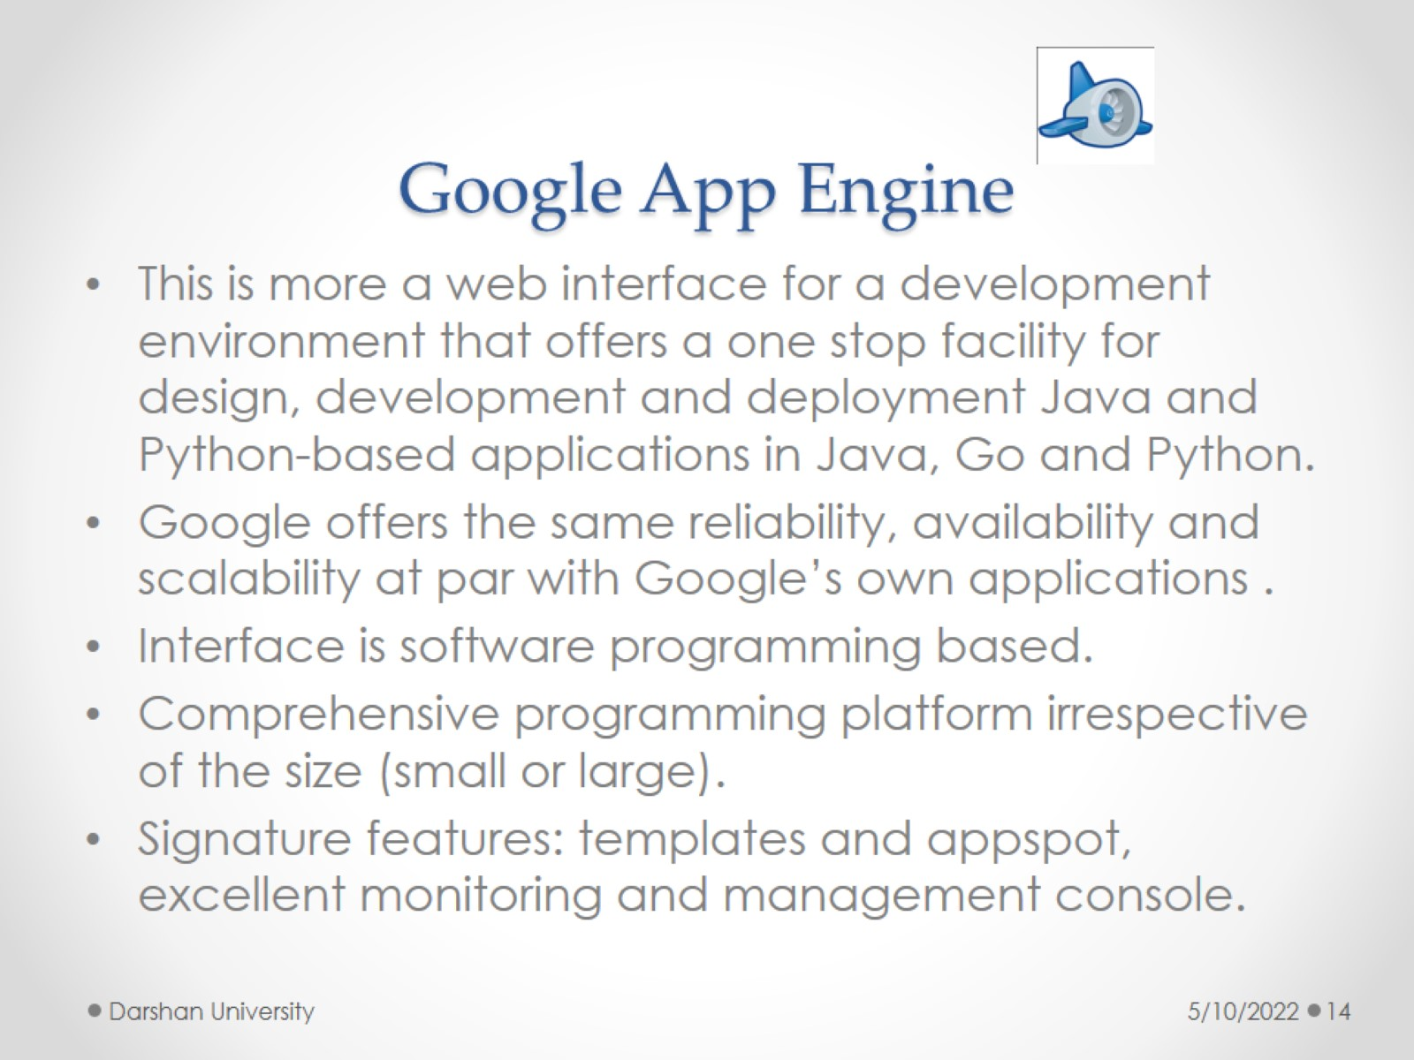
Google App Engine

Slide 15
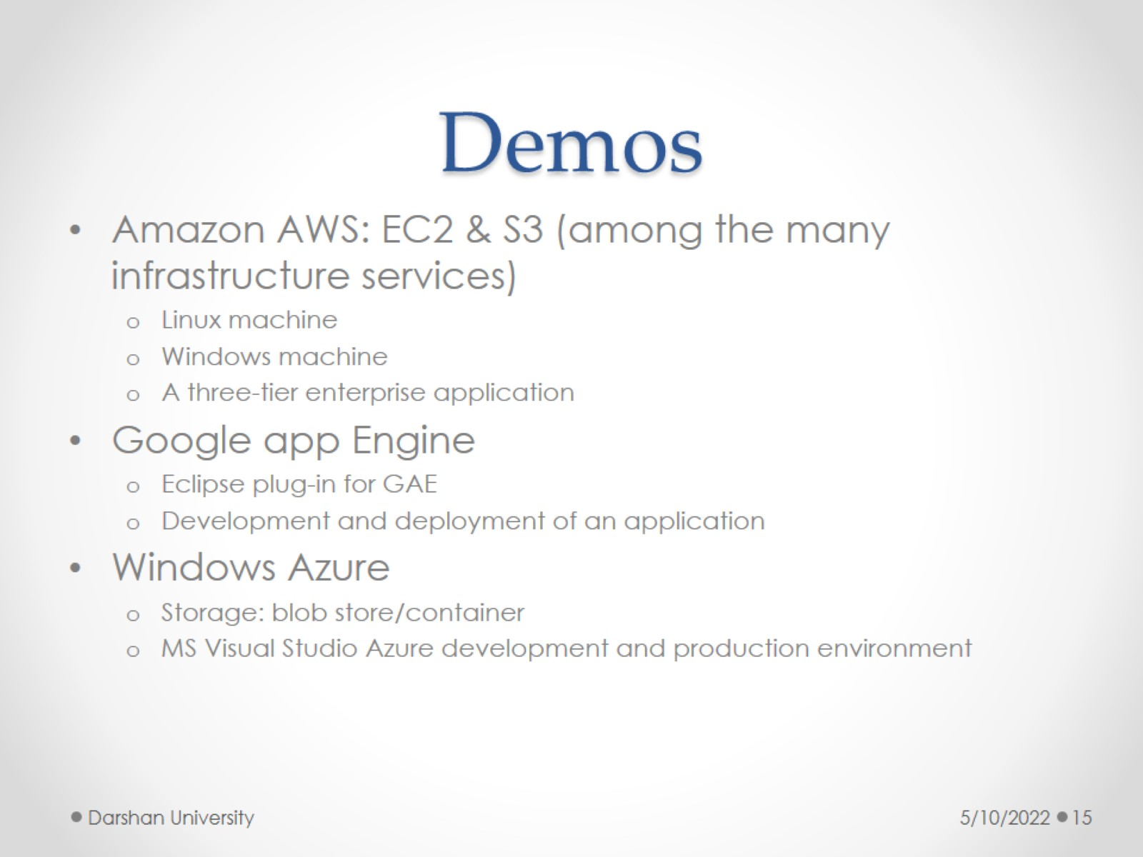
Demos

Slide 16
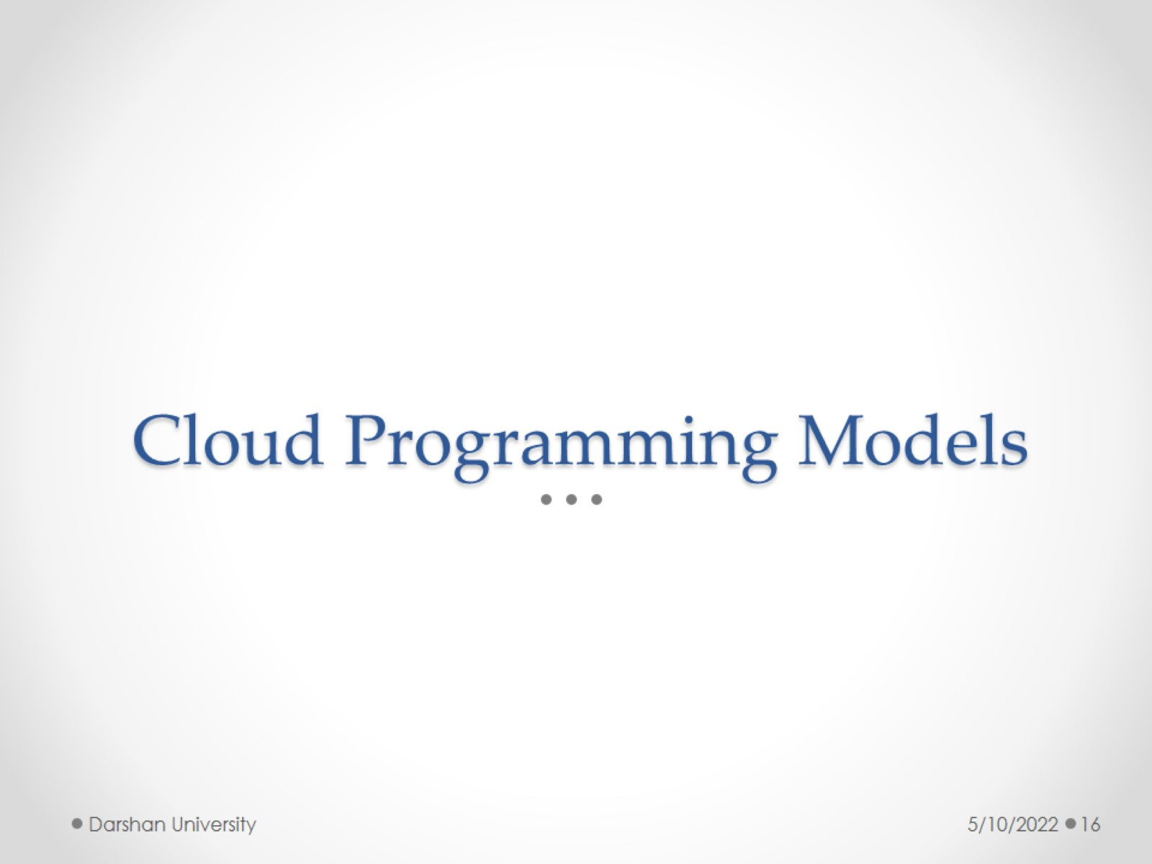
Cloud Programming Models

Slide 17
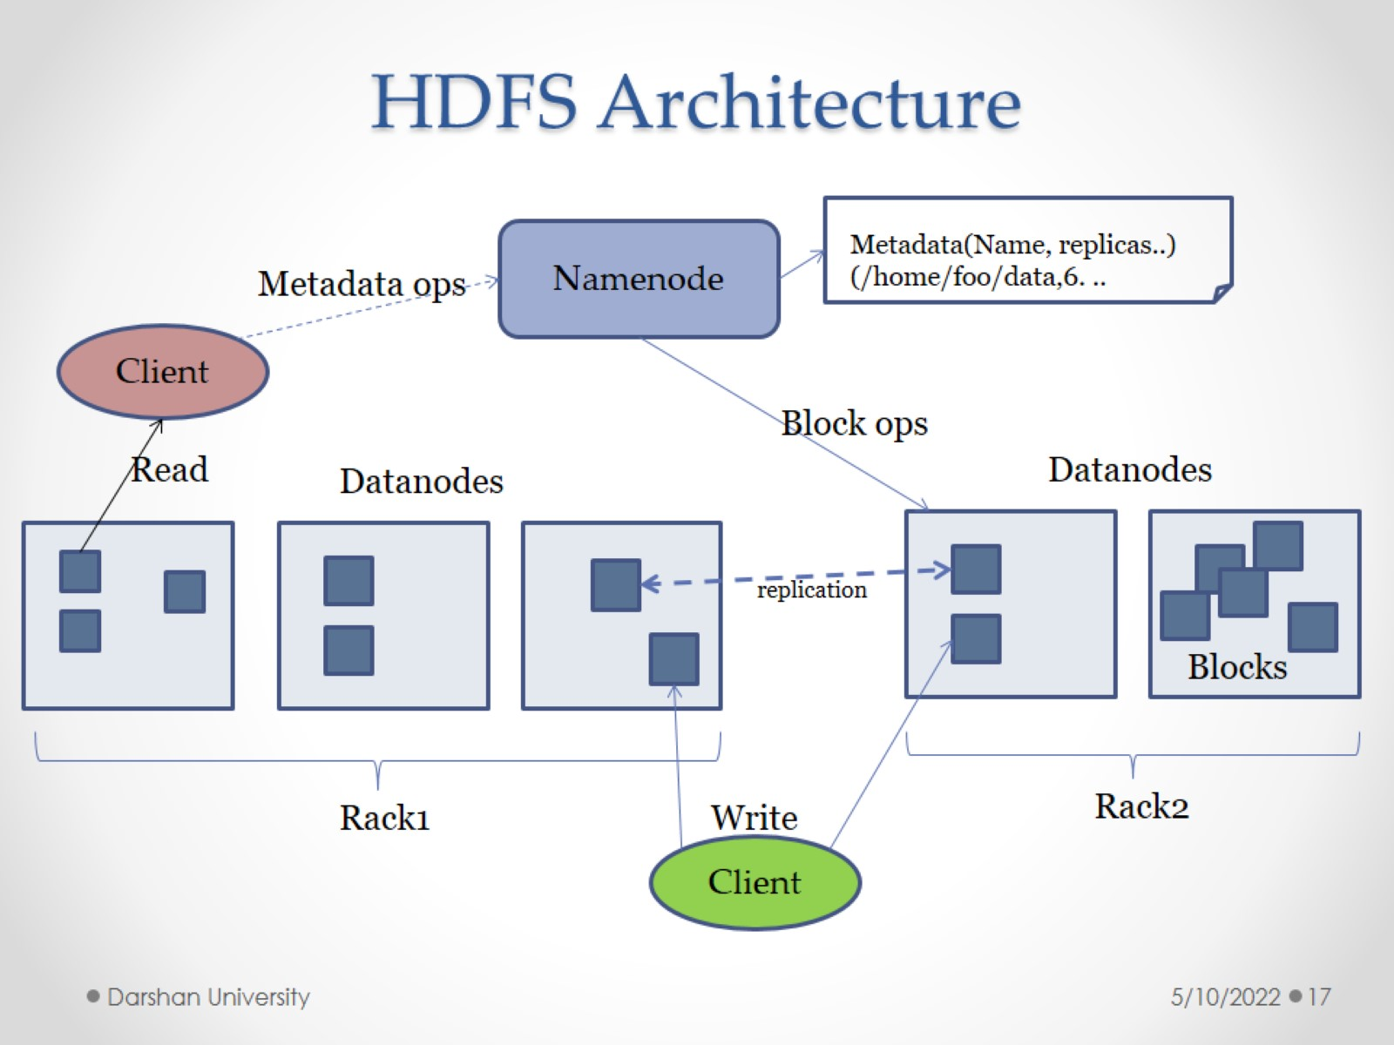
HDFS Architecture

Slide 18
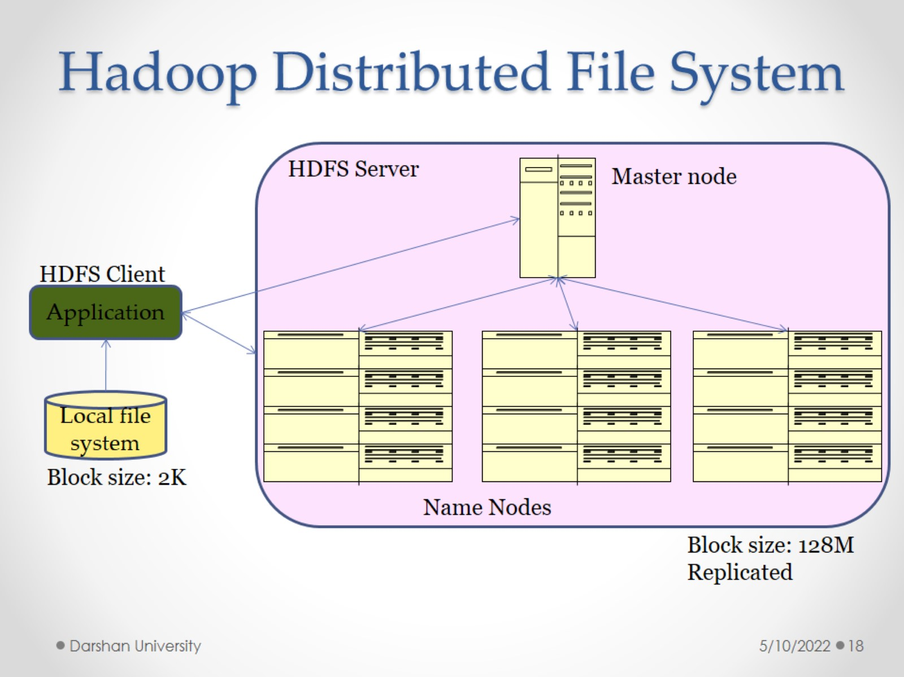
Hadoop Distributed File System

Slide 19
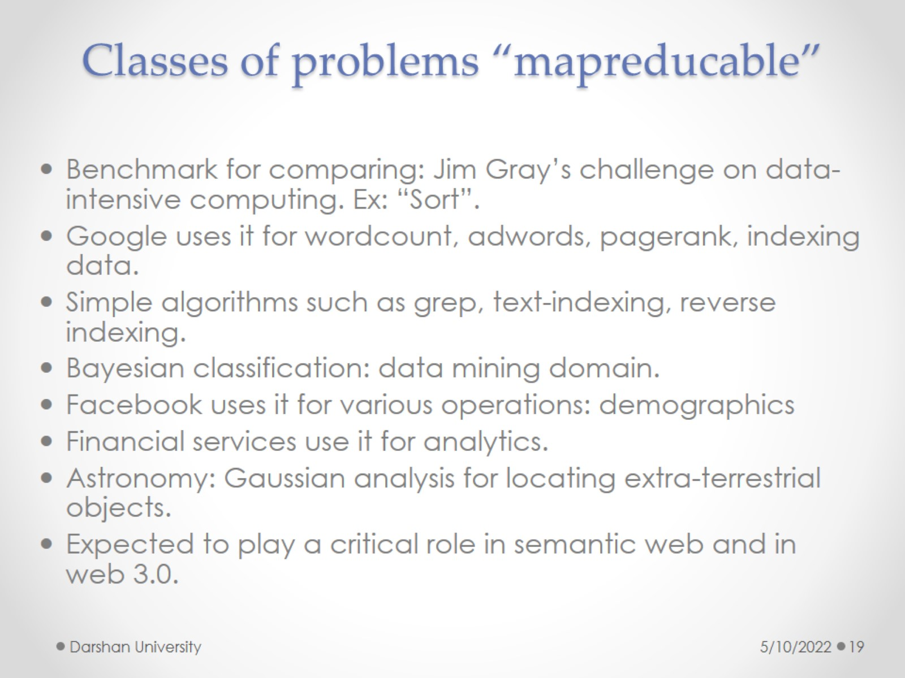
Classes of problems “mapreducable”

Slide 20
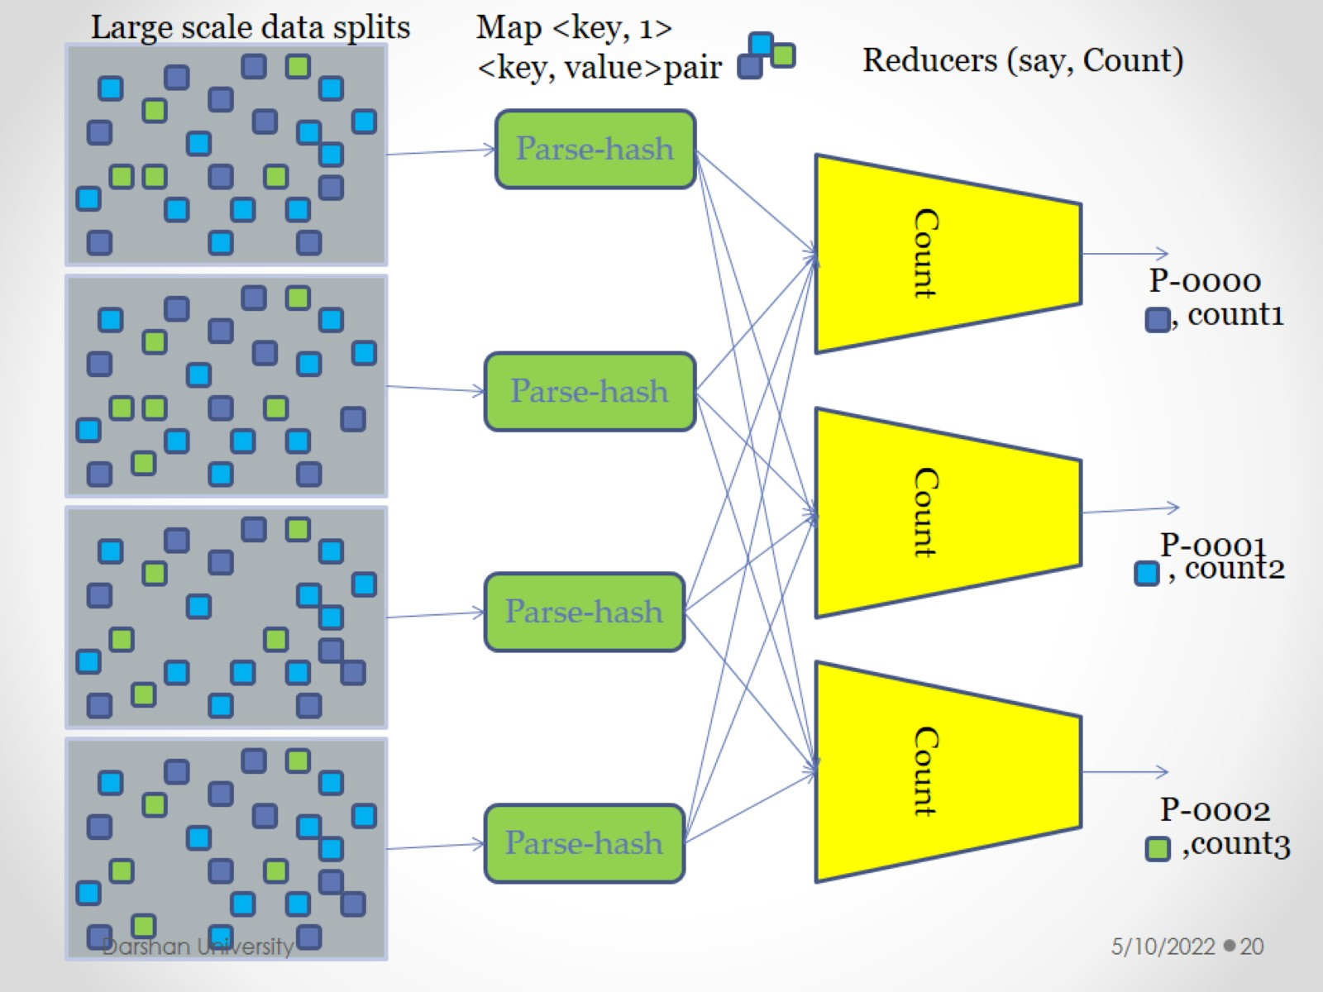

Slide 21
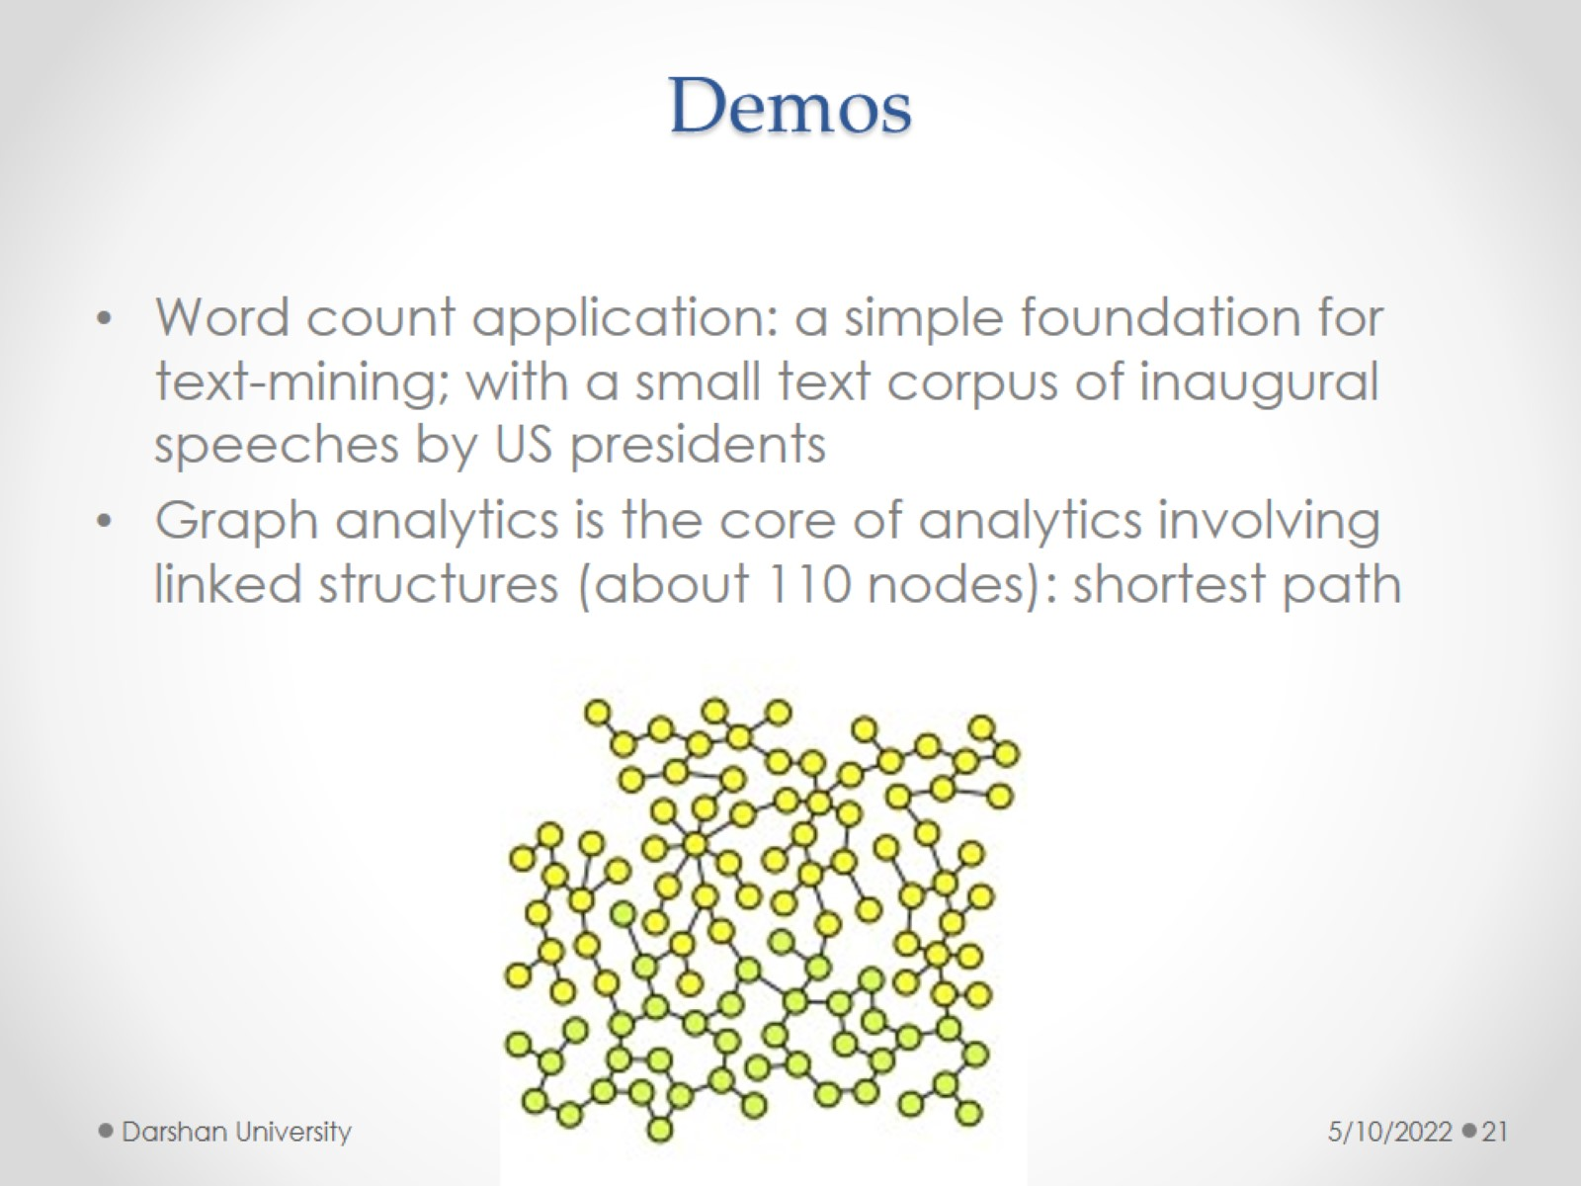
Demos

